Slide 1




Introduction to MapReduce
An overview of the MapReduce framework used for processing large datasets in parallel.
by Gattu Devendra

Slide 2

Overview of HDFS (Hadoop Distributed File System)
Distributed Storage
Scalability
HDFS is a distributed file system designed to store and manage large volumes of data across multiple nodes.
HDFS allows seamless scaling to accommodate the increasing data size by adding more nodes to the cluster.

Slide 3
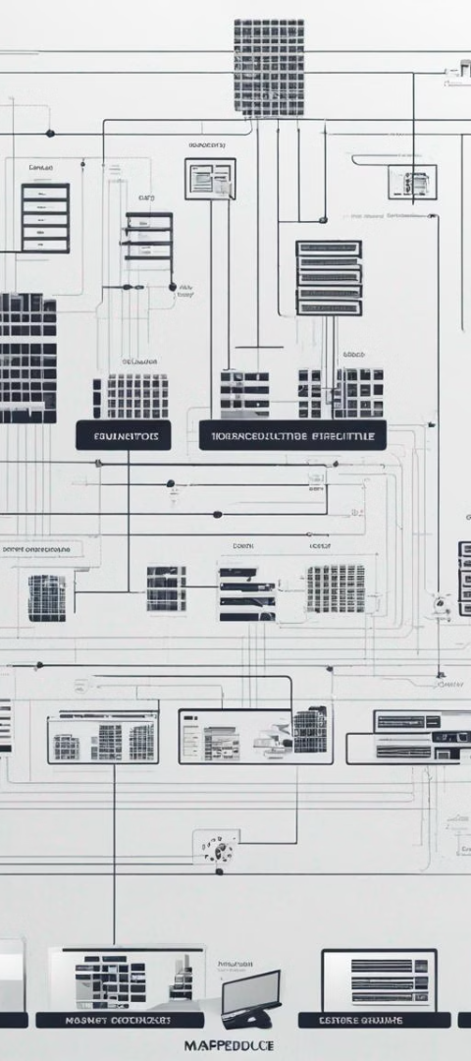
MapReduce architecture
1
Master-Slave Model
2
Parallel Processing
The architecture follows a master-slave model where the JobTracker and TaskTrackers play essential roles.
It is designed for parallel computing, with the ability to process large data sets across clusters of nodes.

Slide 4

MapReduce workflow
1
Map Phase
Data is divided into smaller parts and processed in parallel across different nodes.
2
Reduce Phase
The processed data is aggregated and reduced to produce the final output.

Slide 5

MapReduce job execution
Task Distribution
Node Communication
The job tracker distributes the tasks to the task trackers based on proximity to the data.
Task trackers communicate with the job tracker to provide updates and receive new tasks.

Slide 6



Data processing in MapReduce
Large Datasets
Distributed Computing
Designed to handle and process large-scale datasets efficiently and reliably.
Well-suited for distributed computing across a cluster of nodes.

Slide 7

Fault tolerance in MapReduce
99%
Reliability
MapReduce ensures fault tolerance with a high degree of reliability, ensuring minimal data loss or job failure.
3x
Redundancy
Provides 3x replication to ensure data availability even in the event of hardware failures.

Slide 8



Conclusion and key takeaways
Efficient Data Processing
MapReduce offers a highly efficient method for processing large volumes of data in parallel.
Scalability and Reliability
HDFS and MapReduce together provide scalable and reliable data processing capabilities.

